Slide 1

Gamepub

Slide 2
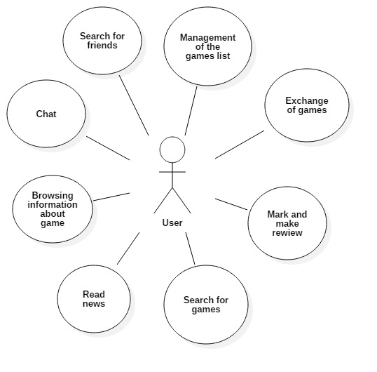
Use cases

Slide 3
Users
Gamers
Collectors
People who want to save money

Slide 4
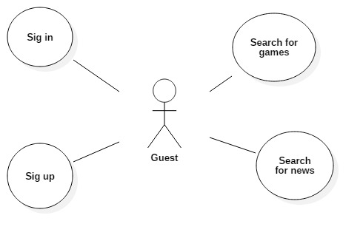
Use cases

Slide 5
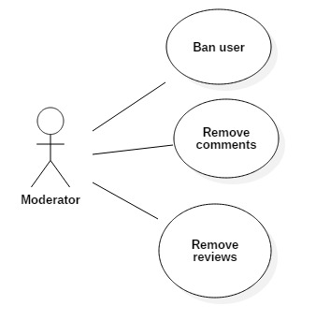
Use cases

Slide 6
Technology stack
Data Layer
PostgreSQL
Business Logic Layer
EJB
JSF
Hibernate
Presentation Layer
Bootsfaces Primefaces

Slide 7






Architecture
Entity objects
Services
Managed Beans
Rest API
JSF
Data Base
Others applications
Web site

Slide 8
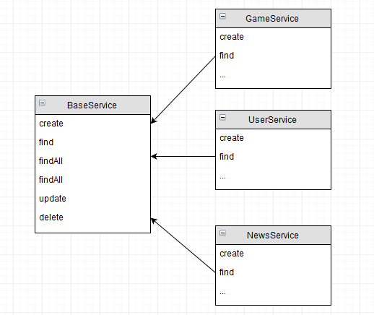
Working with db

Slide 9
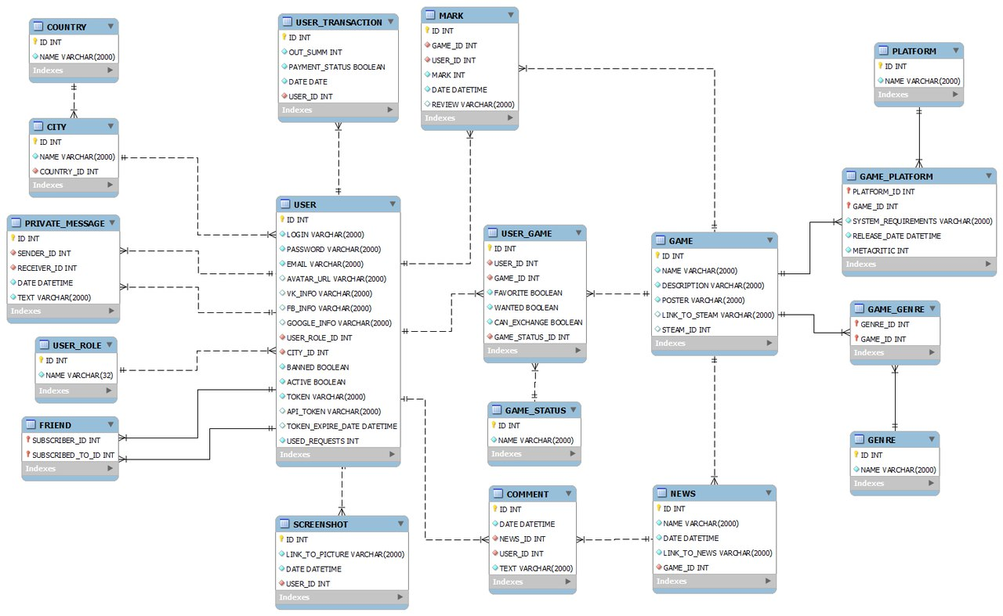
Data base

Slide 10
Getting data

Slide 11
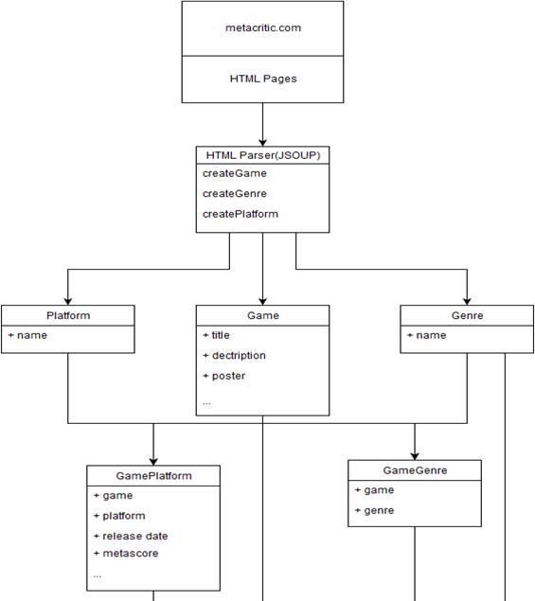
Metacritic.com

Slide 12
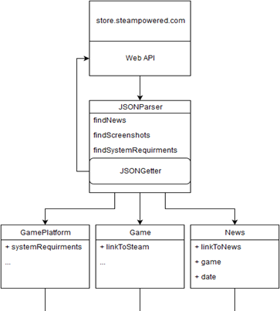
Store.steampowered.com

Slide 13
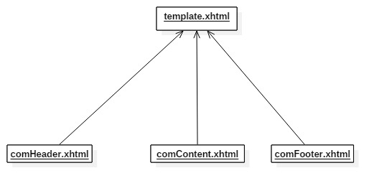
Templates

Slide 14
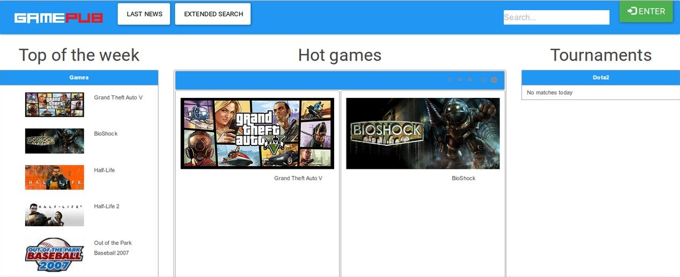
Main page

Slide 15
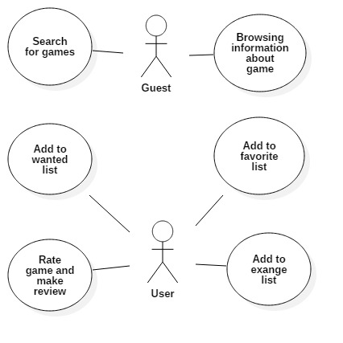
Games and search

Slide 16
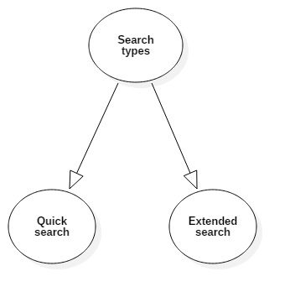
Games and search

Slide 17
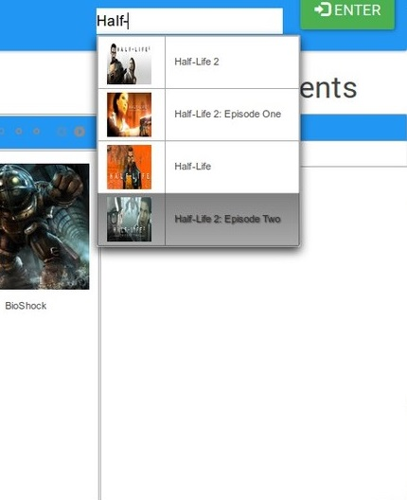
Games and search

Slide 18
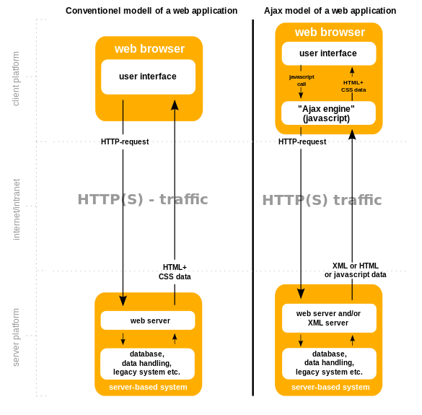
Games and search

Slide 19
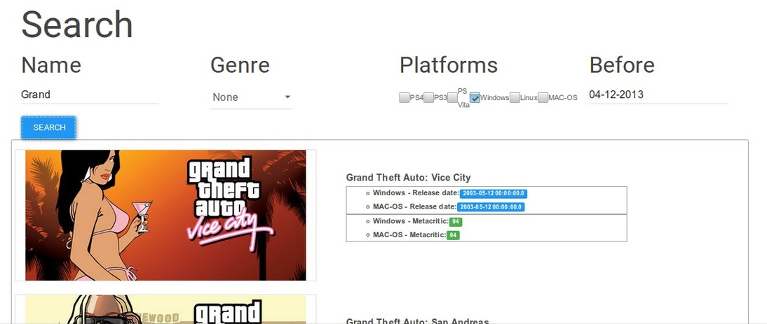
Games and search

Slide 20
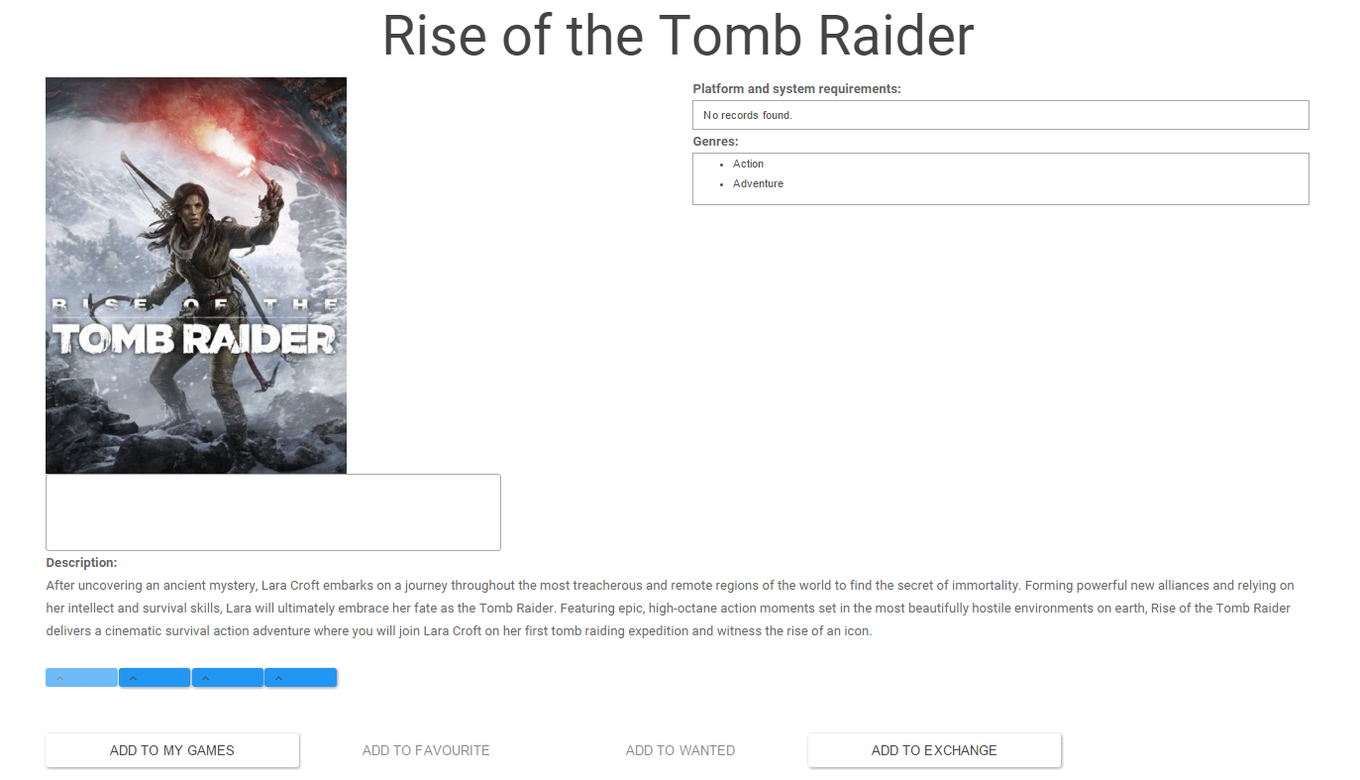
Games and search

Slide 21
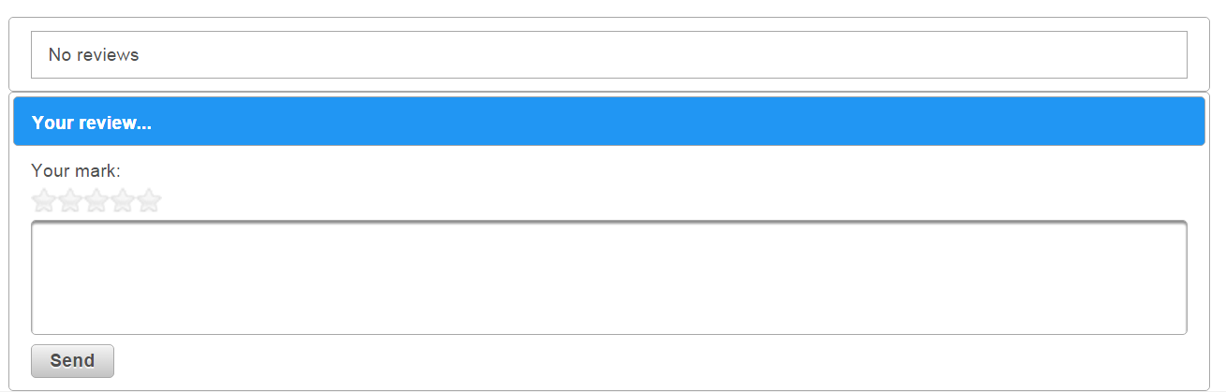
Games and search

Slide 22
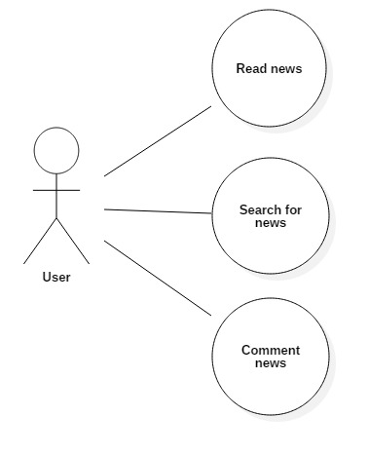
News

Slide 23
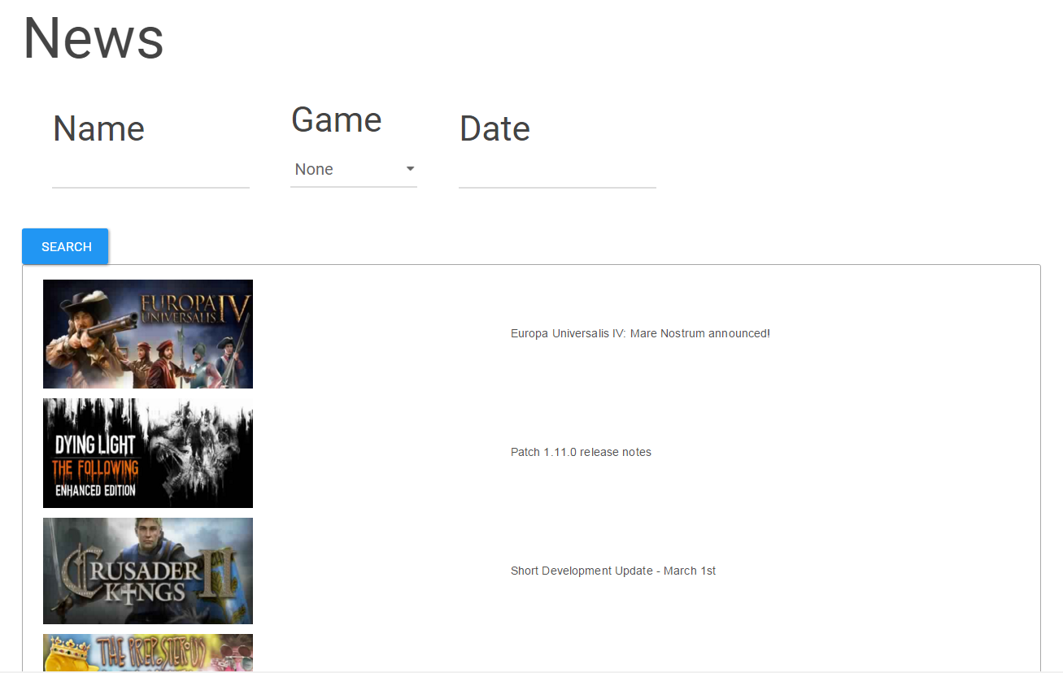
All news

Slide 24
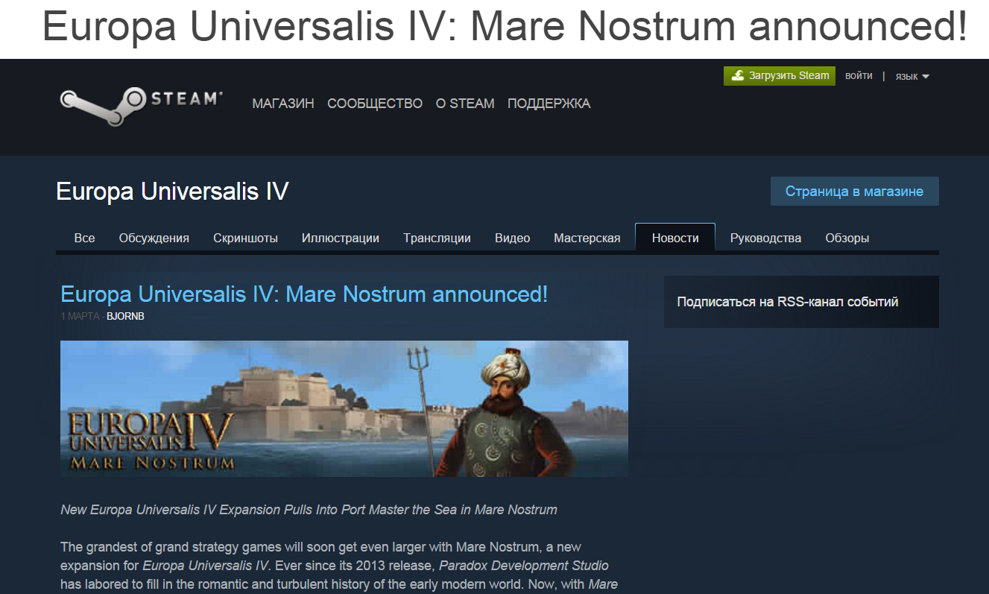
News

Slide 25
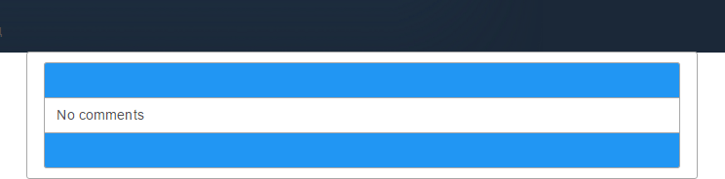
News

Slide 26
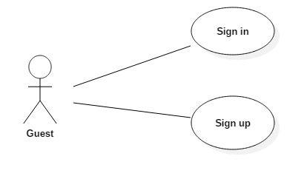
Registration and authorization

Slide 27
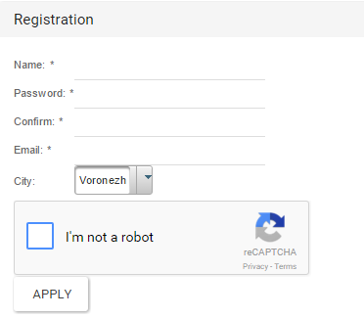
Registration form

Slide 28
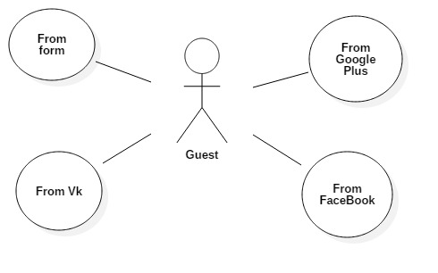
Authorization

Slide 29
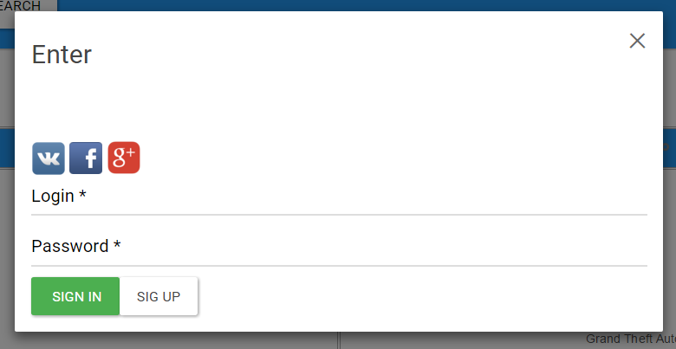
Authorization

Slide 30

OAuth
1.
Appeal to protected resources
Obtaining authorization
2.

Slide 31
OAuth
Consumer
Service Provider
Client ID Redirect URI Scope(optional)
2
1
User grants authorization
Redirect user to Provider for authorization
3
Redirect user back to application
4
Exchange for access grant
Authorization code
Redirect URI Authorization code
5
Grant access token
6
Create connection
Access token

Slide 32
OAuth
Update user
yes
Social network
User id
Name
avatarUrl
Does user exist?
login
no
Create user

Slide 33
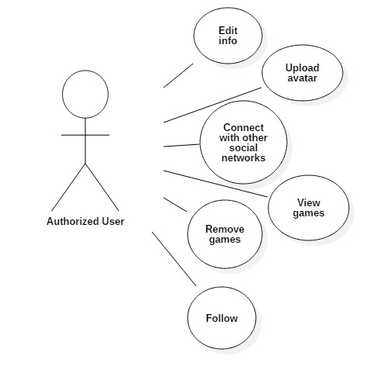
Profile page

Slide 34
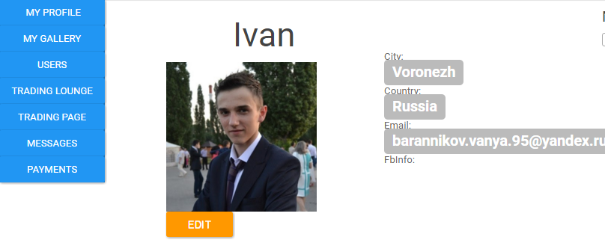
Profile page

Slide 35
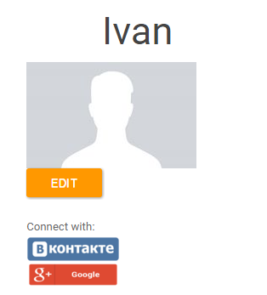
Connecting with social networks

Slide 36
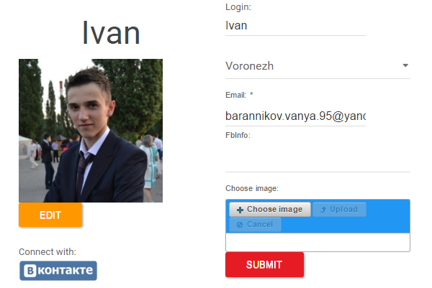
Edit form

Slide 37
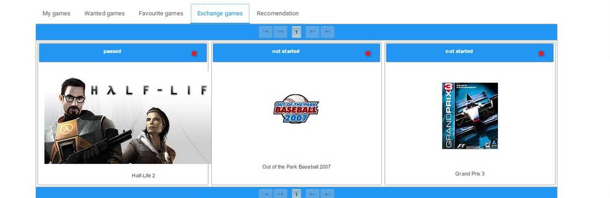
Games data grid

Slide 38
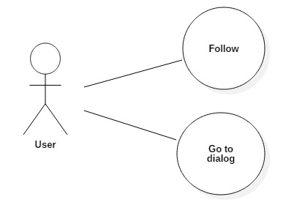
Follow

Slide 39
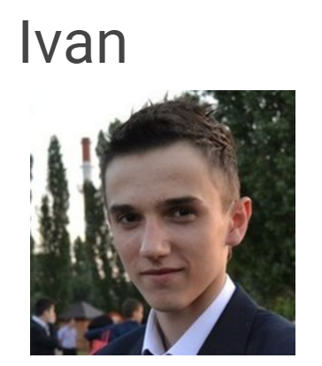
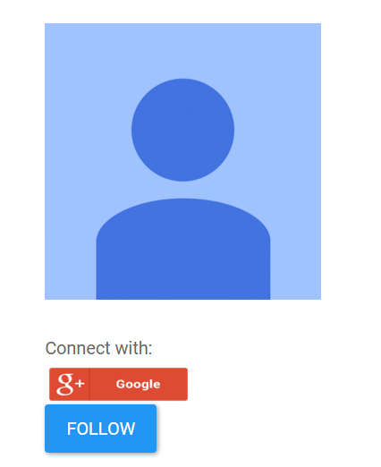
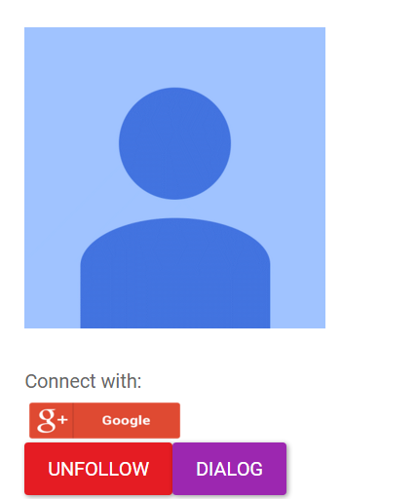
Follow

Slide 40
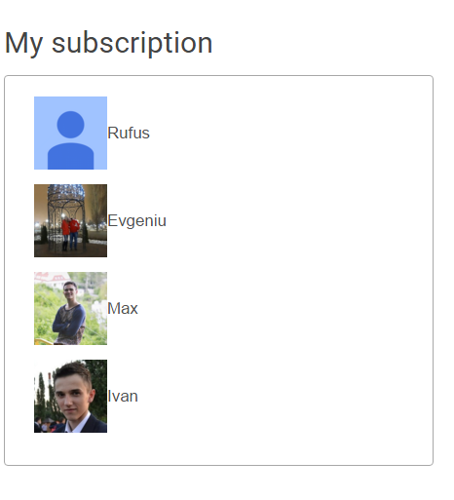
Subscription list

Slide 41
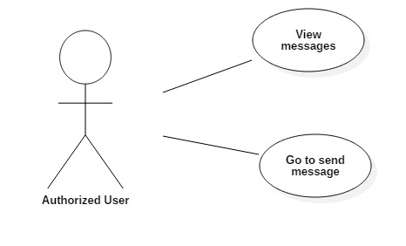
All message page

Slide 42
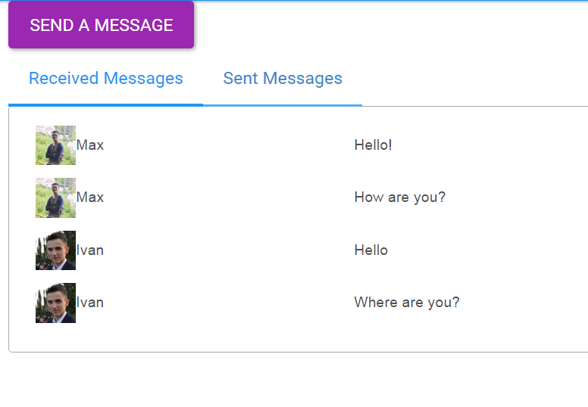
All message components

Slide 43
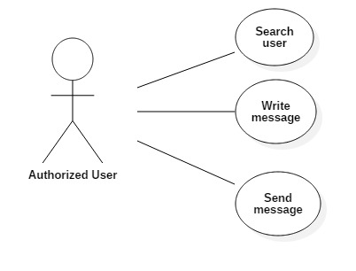
Message page

Slide 44
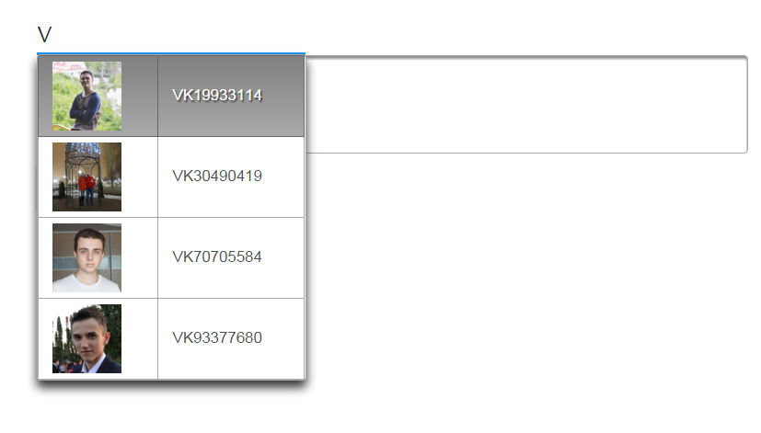
Search component

Slide 45
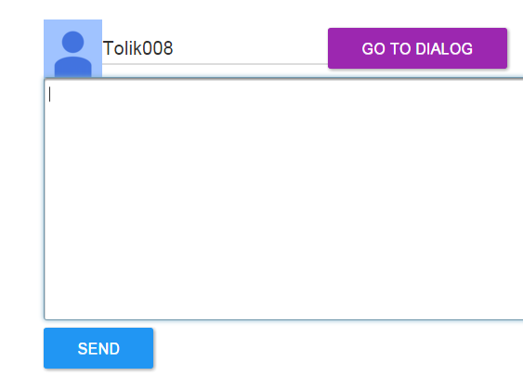
Input component

Slide 46
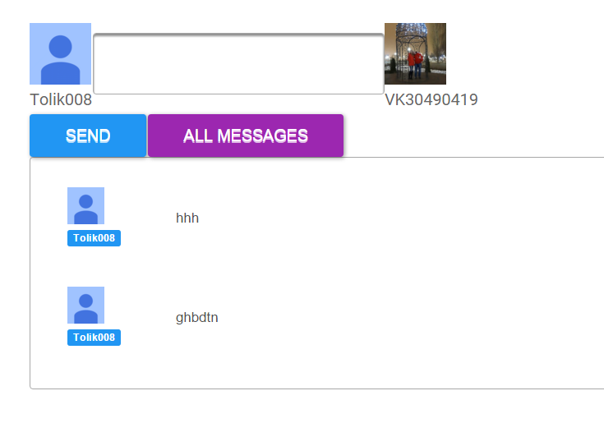

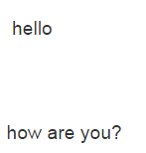
Dialog component

Slide 47
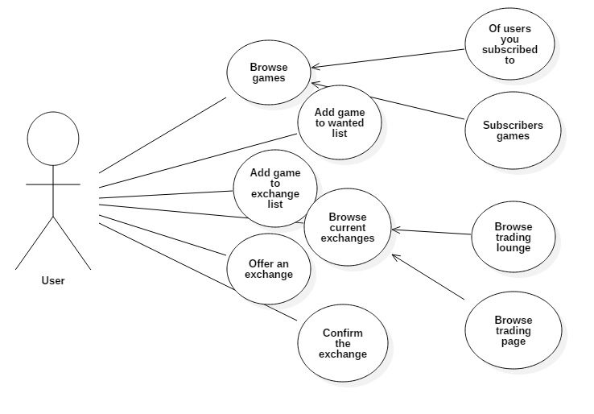
Exchange system
Authorized user

Slide 48
Exchange system
User 2
User 1
Wanted games
Wanted games
GTA 5
Witcher
Witcher
FarCry
Fallout
Crysis
Exchange games
Exchange games
FarCry
GTA5
StarCraft
Fallout
Warhammer
Skyrim

Slide 49
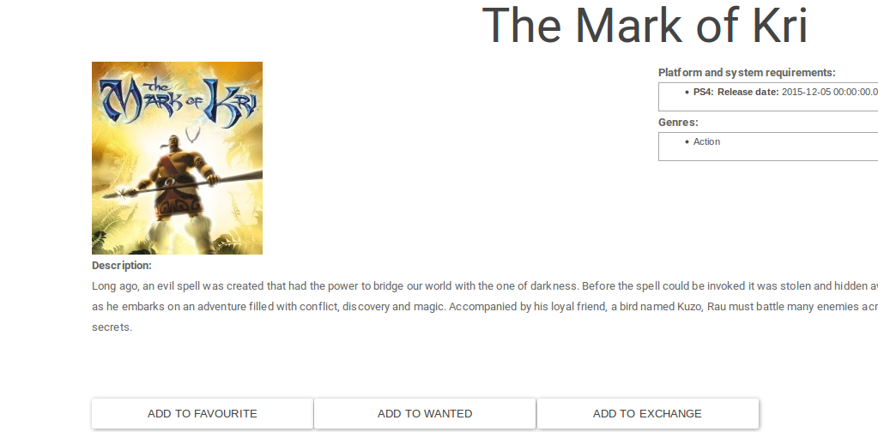
Exchange system

Slide 50
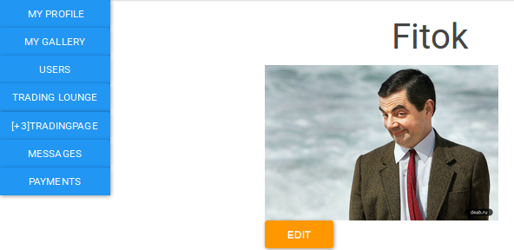
Exchange system

Slide 51
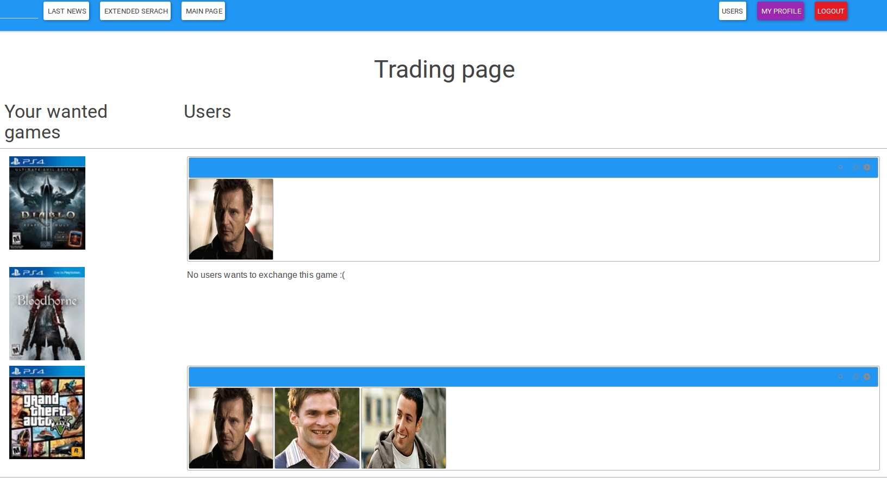
Exchange system

Slide 52
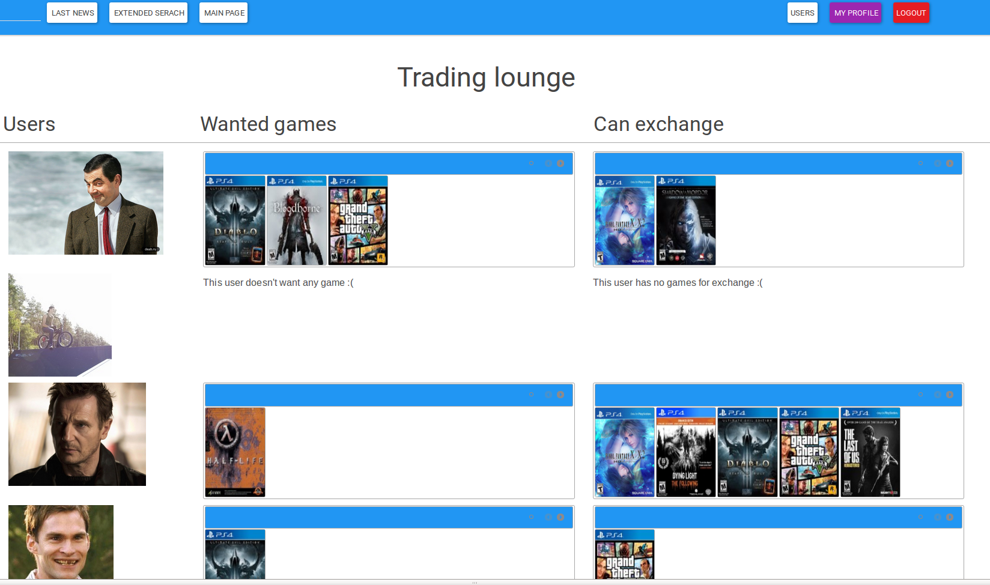
Exchange system

Slide 53
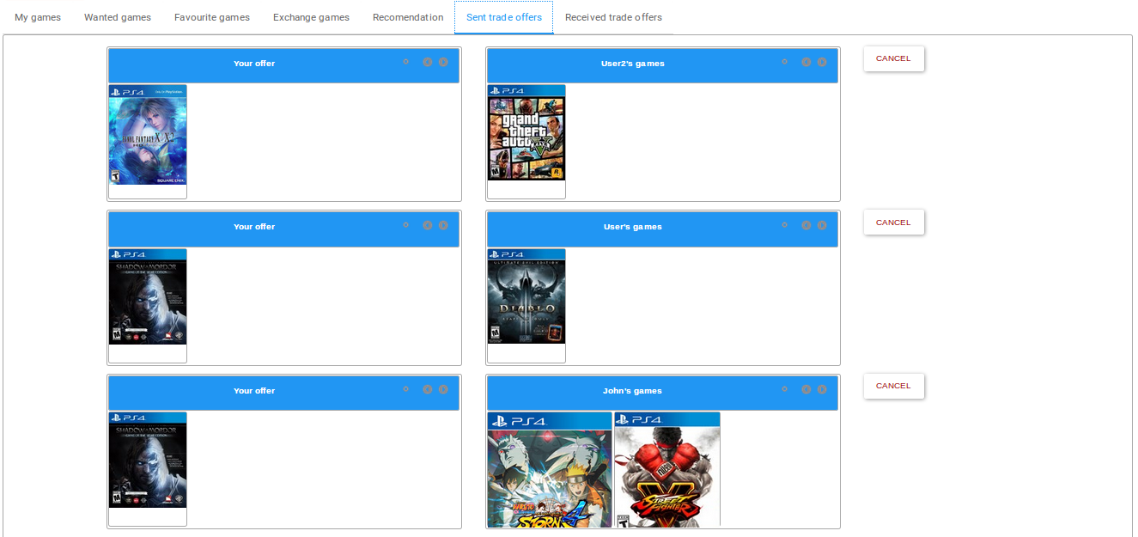
Exchange system

Slide 54
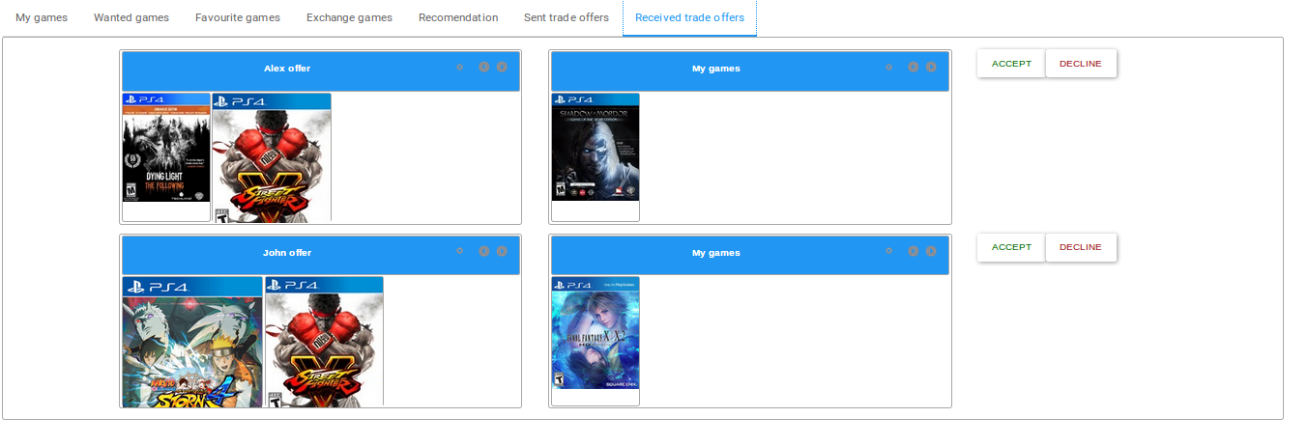
Exchange system

Slide 55
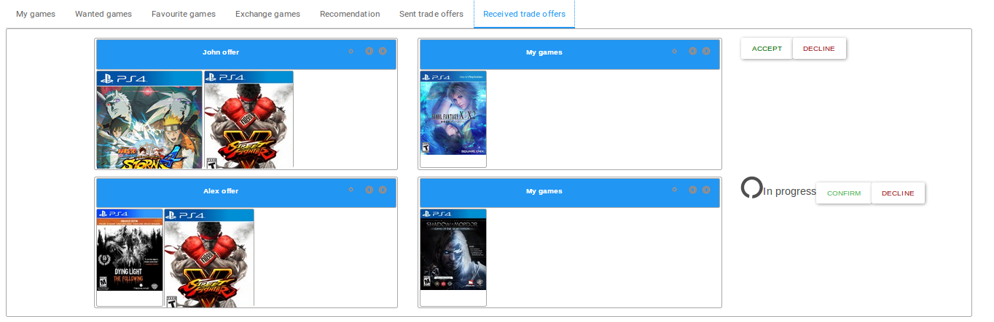
Exchange system

Slide 56
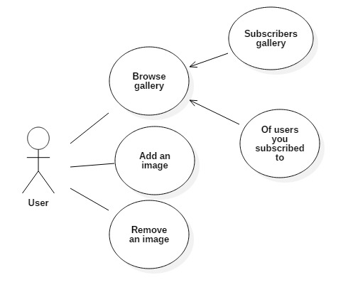
Gallery

Slide 57
Image uploading/removing
Upload/remove
Images
Uploaer
class
Cloudinary Java API
Gamepb cloud
Image parameters map

Slide 58

Gallery

Slide 59

Payments

Slide 60
Robokassa
1
2
Fill form
Create post request
3
Redirect user to robokassa
4
Payment’s holding
Post request to server
Succesful payment
Unsuccesful payment
Processing answer
Redirect user to succesful page
Redirect user to fail page

Slide 61

Payments

Slide 62

Payments

Slide 63

Robokassa

Slide 64

Gold account

Slide 65
Demo

Slide 66

Questions time

